Slide 1
Driving Safety Culture Home
A special safety presentation
1
Notes:
This 20-30-minute interactive presentation has been developed to assist you with kicking off your work-site seat belt usage improvement campaign. The intended audience is all employees, not just company vehicle drivers. The majority of the presentation has been scripted with information you may use as-is or customize. There are a few places that you will need to customize to fit your needs.
Please note the opportunities to make the presentation interactive. The more you can engage your audience in discussion, the better your message will be retained. Although a “script” is provided to aid you, after becoming familiar with the material, feel free to “make it your own”.

Slide 2
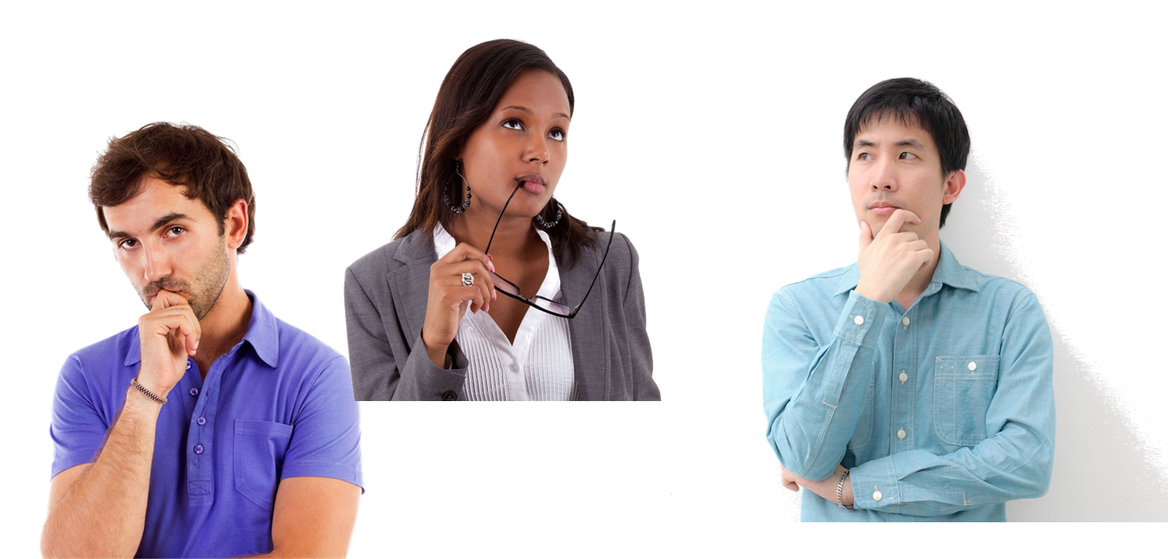
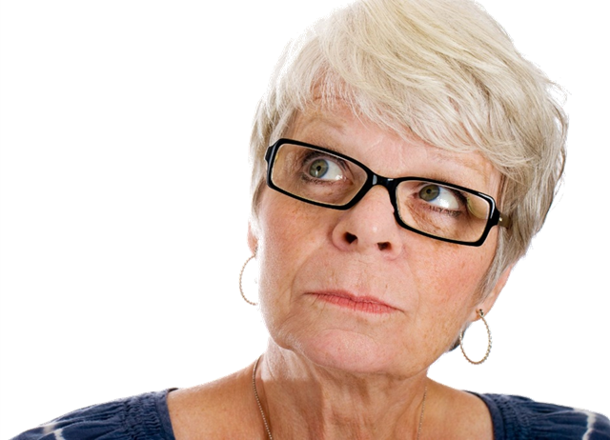
Question
What is the most important thing you will do today?
2
Notes:
Welcome employees to the meeting. This slide is for contemplation only…no need to answer the question at this time.
Provide details on why sharing this information is important to you personally and professionally (for example, talk about the company’s commitment to safety and leading by example, etc.)
Acknowledge that for some people, the topic of this presentation may fall under the category of “preaching to the choir” but that you are confident each and every person in the room knows at least one person who could benefit from the information they are about to hear and it is your hope they will share what they hear with others.

Slide 3
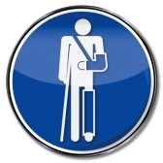

The problem
Physical
Financial
3
Notes:
Let’s talk for a few minutes about something that is vitally important to all of you. This is a problem that will likely cause each and every one of you some degree of personal suffering.
It can affect your physical mobility and cost you financially in healthcare insurance deductibles, lost work time and money in general that could be used for vacations, home improvements, entertainment and other benefits.
Presenter’s Note: Ask, “Can anyone guess what I’m talking about?” Take answers from a few members of the audience.

Slide 4
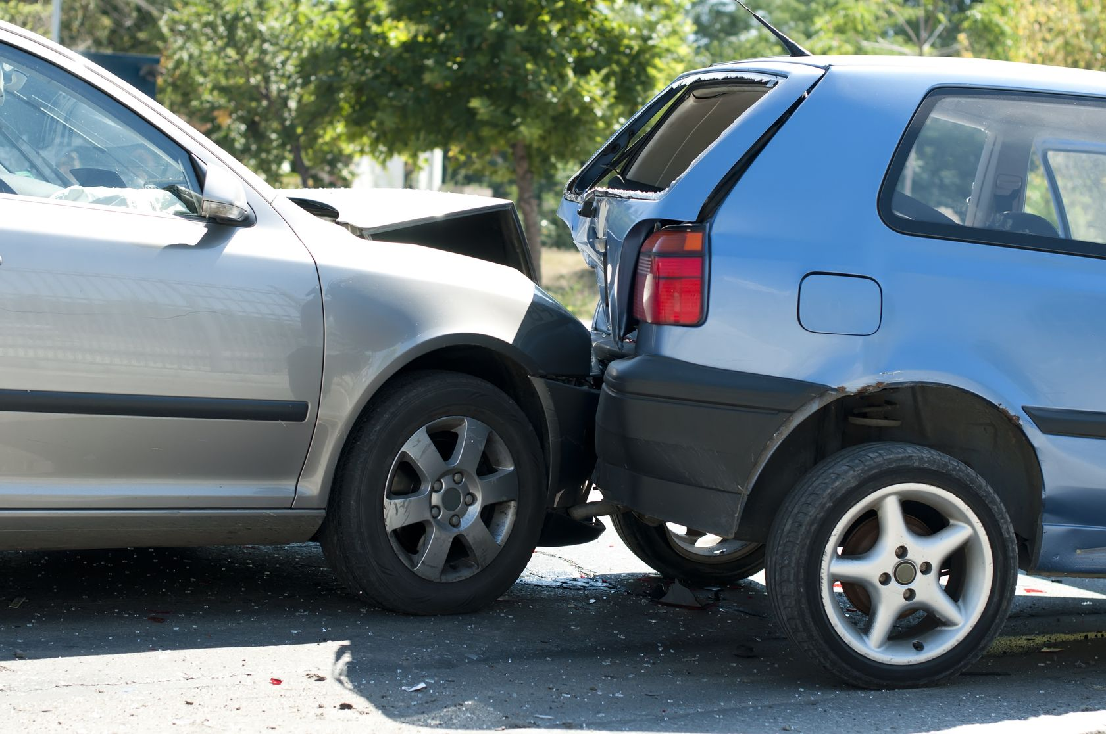
Crashes are never planned
4
Notes:
The problem that has the potential to affect each one of us in the room today—if it hasn’t already—is related to motor vehicle crashes.
Presenter’s Note: Ask, “How many of you have been in a crash of any magnitude?
Take a count and figure an approximate percentage.
Now ask, “How many of you planned for that to happen when you left your driveway or the parking lot that day?”

Slide 5
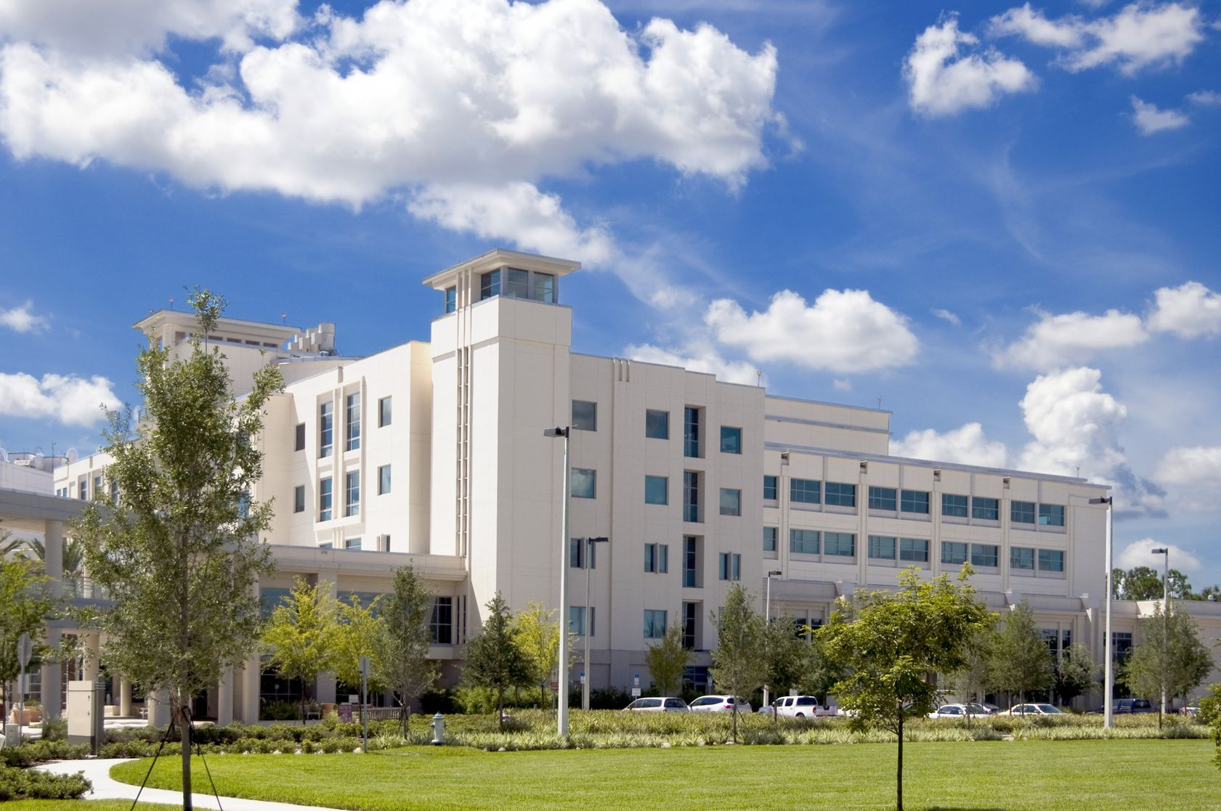
The force of a 30 mph crash…
Is roughly equivalent to falling out of a third floor window
5
Notes:
Would anyone here zip line without a harness? Water ski or jet ski without a life preserver? If you aren’t wearing your safety belt all of the time, you’re taking a similar risk.
Consider this. At the moderate speed of 30 mph, a motor vehicle crash would throw you forward with a force equal to 30 times your body weight. If, for example, you weigh 150 lbs, you would be thrown forward with a force of 4,500 pounds! That is roughly equivalent to falling out a third-floor window.

Slide 6
In the U.S. in 2012…
22,912 passenger car and light truck drivers and occupants died in motor vehicle crashes
10,335 were not wearing a seat belt (52%)
Of those, 5,471 were ejected or partially ejected (53%)
A person is 4x more likely to be fatally injured when thrown from the vehicle.*
6
Notes:
Here’s another thing to consider. In 2012, 22,912 drivers and passengers died in motor vehicle crashes. 52% of those were not wearing a seat belt and of those, more than half were ejected or partially ejected.* When ejected from a vehicle, you have JUST a 1 in 4 chance of surviving. In a crash, your safety belt is your safety net.
*Data from the National Highway Traffic Safety Administration Traffic Safety Facts 2012.

Slide 7
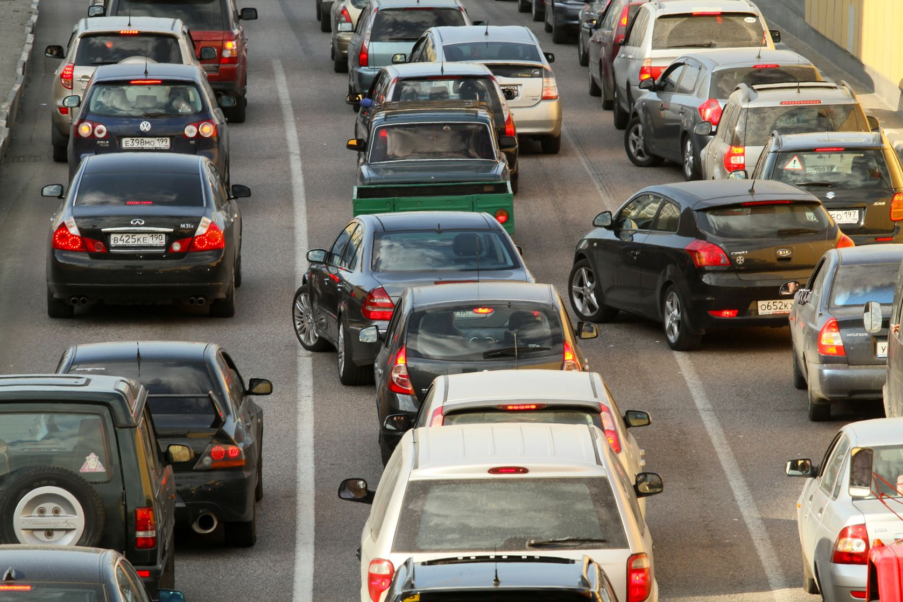
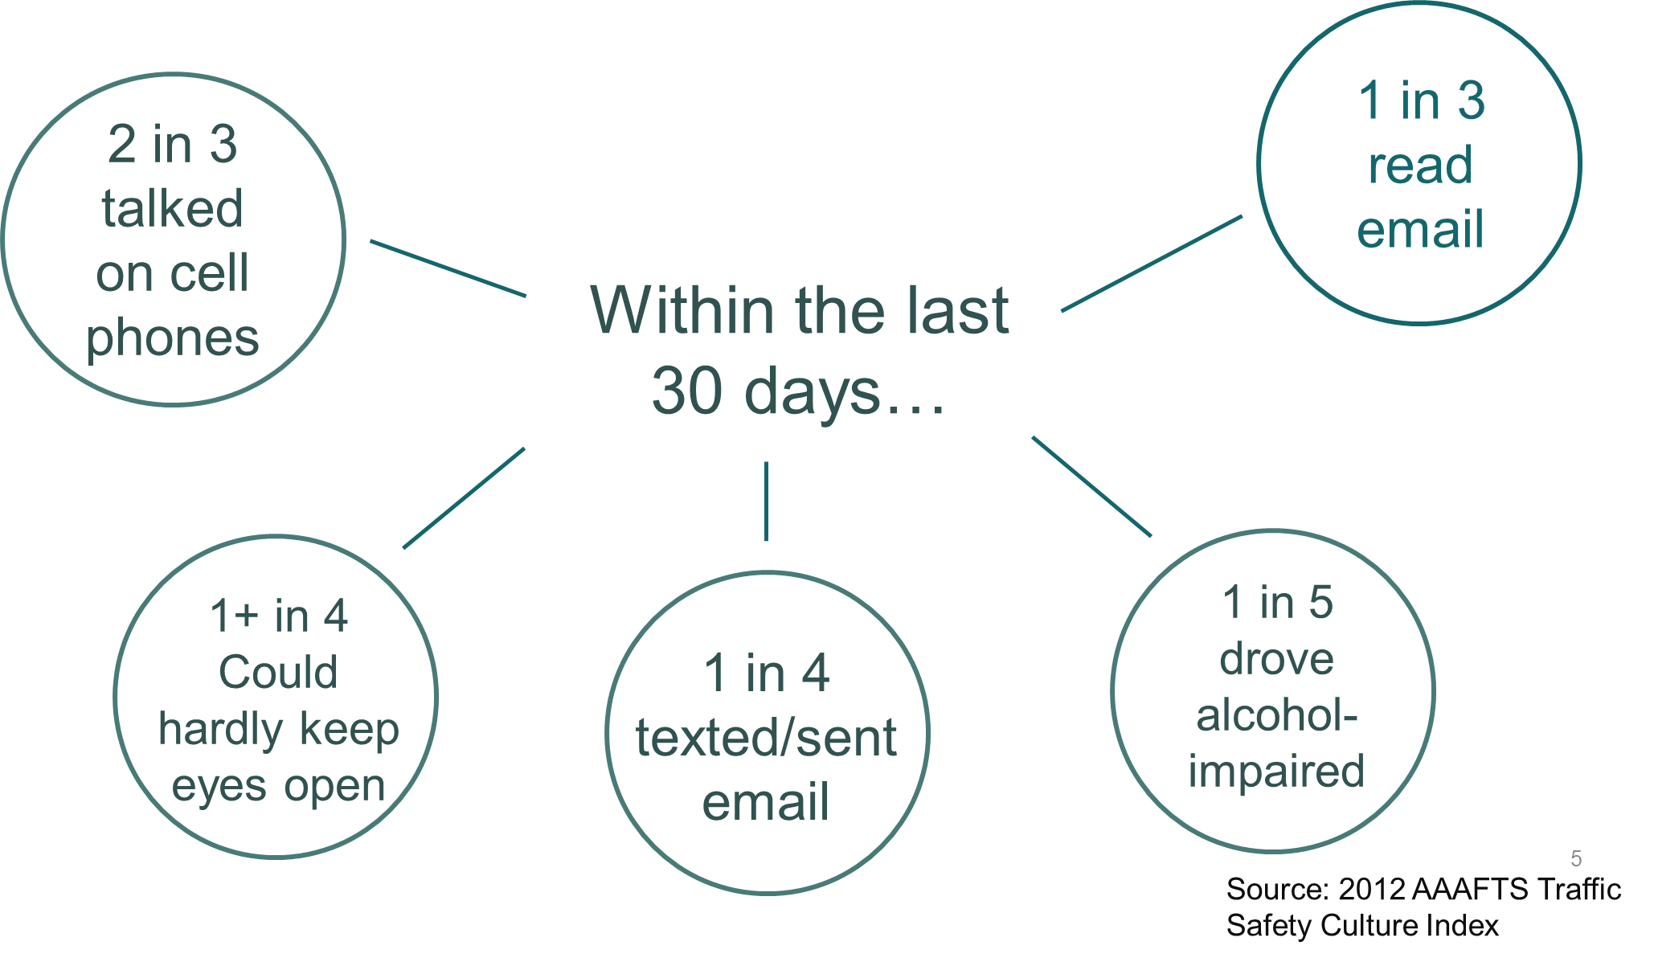
Who is out there with you?
7
Notes:
I know you’re thinking it will never happen to you– after all, you’re a pretty good driver, right? But let’s take a moment and think about who is sharing the roads with you. According to AAA (the 2013 AAA Foundation for Traffic Safety’s annual Traffic Safety Culture Index), these are the driver’s we’re keeping company with out on the road .
(Review slide)
When asked about their driving over the past 30 days…
2 in 3 drivers admitted to talking on cell phones while driving;
1 in 4 texted or sent email;
1 in 3 read email;
1 in 5 admitted to driving while too impaired by alcohol to do so safely;
More than 1 in 4 reported having driven while so tired they could hardly keep their eyes open.
What are the chances you won’t someday meet one of these people by “accident?”

Slide 8
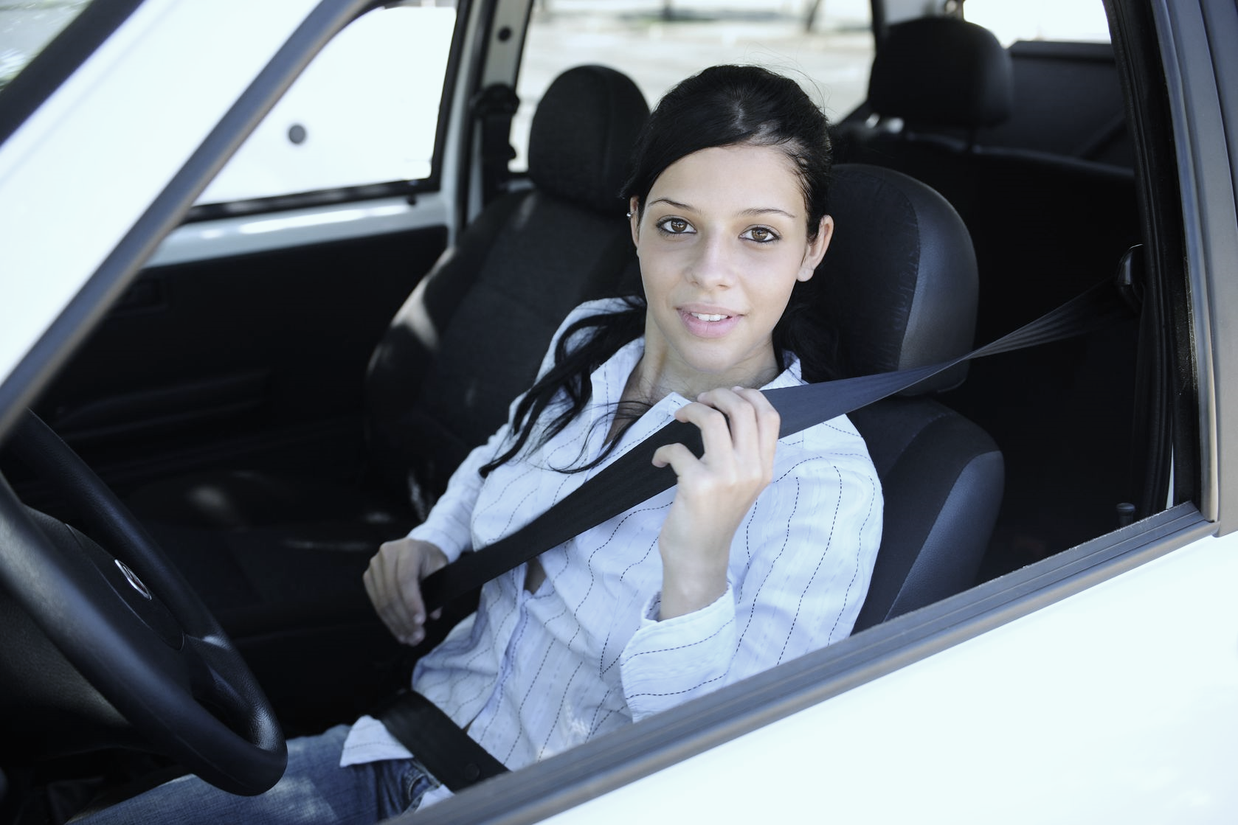
Seat belts are your best defense
Reduce the risk of fatal injury to front-seat passenger vehicle occupants by 45%
Reduce the risk of moderate-to-critical injury by 50%
Reduce the risk of fatal injury to light truck occupants by 60%
Reduce the risk of moderate-to-critical injury to light truck occupants by 65%
Source: NHTSA
8
Notes:
In reality, your chances of being involved in a crash are statistically high. But, there is something you can do about it. It has been proven that the single most effective thing you can do to protect yourself in a crash is to BUCKLE UP. SEAT BELTS ARE YOUR BEST DEFENSE.
When correctly used, it is a simple fact that wearing your seat belt can reduce your risk of dying in a traffic crash by 45% in a car and by as much as 60% in a truck or SUV. Risk of moderate-to-critical injury is reduced by 60 and 65% respectively.
Imagine living with a permanent disability such as a head injury that could have been prevented by something as simple as clicking your seat belt. Among all age groups, motor vehicle crashes are the second-leading cause of Traumatic Brain Injury (17.3%) and result in the largest percentage—roughly a third– of Traumatic Brain Injury-related deaths (31.8%)*
Presenter’s Note: Ask, “How many of you wear your seat belts?” Take a count. (Ask that they keep hands up) “Now, how many of you wear your seat belt on every trip?”
*Source: Centers for Disease Control and Prevention (CDC), Faul M, Xu L, Wald MM, Coronado VG. Traumatic brain injury in the United States: emergency department visits, hospitalizations, and deaths. Atlanta (GA): Centers for Disease Control and Prevention, National Center for Injury Prevention and Control; 2010.

Slide 9
Part-timers
What are reasons people give for not buckling up all the time?
9
Notes:
Presenter’s Note: Ask the audience what they think are reasons people give for not buckling up all the time…. (Common reasons: “They are not driving far” “just driving in the neighborhood”, they “forget”, “it takes too much time.”)

Slide 10
Not driving far? Not a good excuse.
Most crashes occur within 25 miles (or 40 km) or less from home
Large insurance company study showed 25% of crashes happened within 1 mile (1.6 km) of home
80% of deaths and injuries occur in vehicles traveling < 40 mph (64 km)
10
Notes:
Those of you who put your hands down are considered “Part-timers.” Most commonly, part-timers perceive themselves to be safe traveling short distances. But statistics show that most crashes occur within 25 miles of home and 80% of deaths and serious injuries occur in cars that are traveling under 40 MPH. (Source: NHTSA)
Source for first and third bullets: NHTSA.
Source for second bullet: Progressive Insurance, 2001.

Slide 11
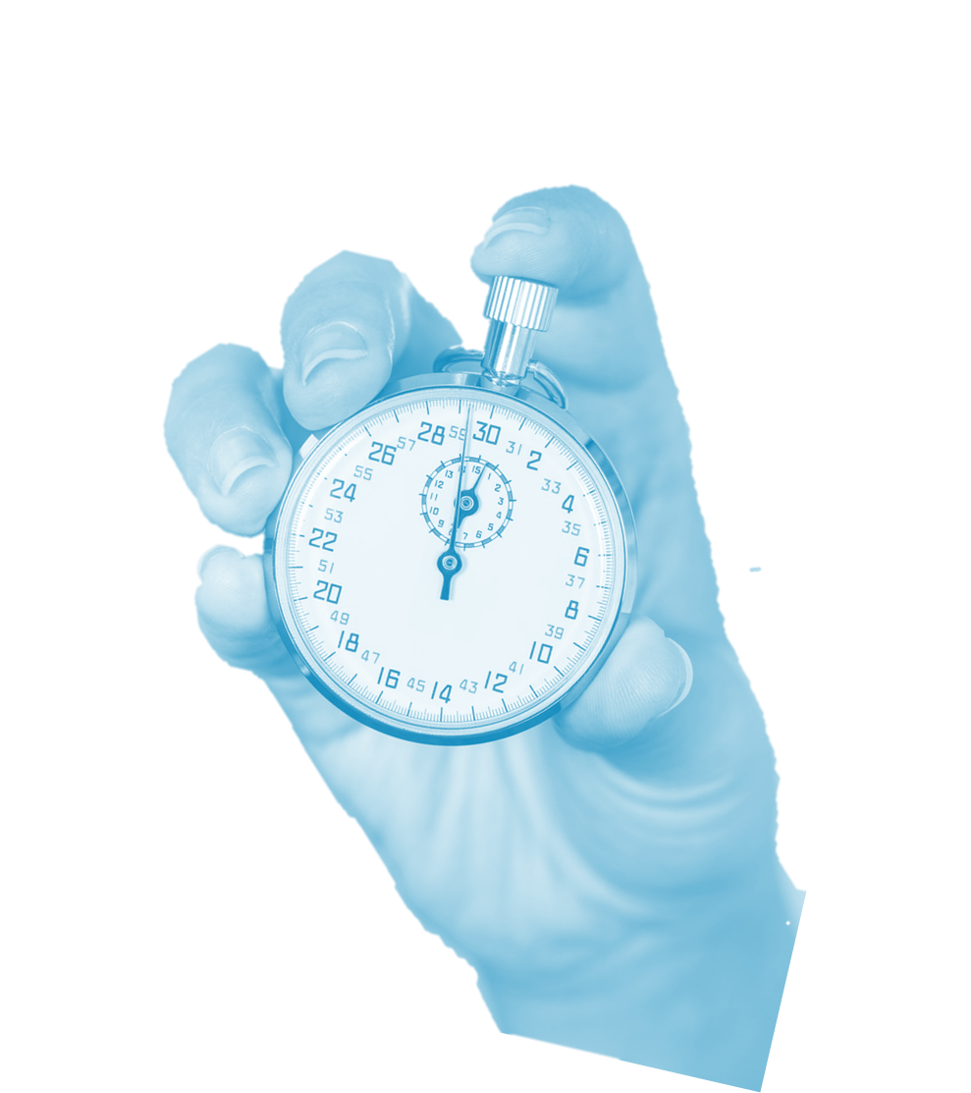
It takes too long? Not a good excuse.
“I’m in and out of my vehicle 20 times a day making customer stops. I don’t have time to buckle up.”
“I’m just going to the corner store. It’s not worth the time…”
11
Notes:
“I’m just going to the corner store…”
“I’m in and out of my vehicle 20 times a day making customer stops...”
“…it’s not worth the time to buckle up…”
Time is a typical concern of part-time seat-belt users. The truth is, it takes just 2-3 seconds to buckle your seat belt. Even if you make 20 stops per day, that is equal to one minute. ONE MINUTE!
Think of your family, think of your friends, think of your health and your well being. When you really think about what you’ve got to lose, the decision seems all too easy. Our chances of being involved in a crash of any magnitude are pretty high and if we aren’t wearing our seat belts, there is a high probability we’ll be injured. Is that a chance that you’re willing to take?

Slide 12
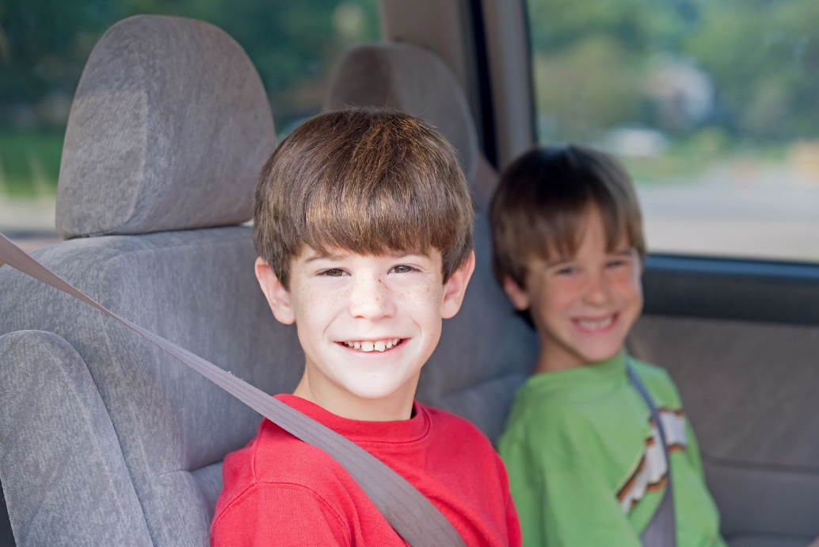
If you do, they will too
Traffic crashes are a leading cause of death/injury to children
Driver buckled = kids buckled 92% of the time*
Driver unbuckled = kids buckled 64% of the time*
*Source: NHTSA
12
Notes:
Another common consideration of a part-timer is to consider who is with them in the vehicle. If you have kids of any age, it’s important to set the right example. Research has proven that children model adult behavior. If adults don’t consistently buckle up, neither will their children. A couple things to think about here: If you have kids and don’t have a family policy of wearing a seat belt any time the wheels are in motion, your kids will be left to decide when they should or don’t need to buckle up when you’re not with them. You don’t want that. Secondly, if you’re one who buckles up when the kids are in the car but only some of the time when they are not, you should consider the possible consequences… Who would take care of them if you are injured and unable to do so, or worse yet…no longer around?
(Source for stat: NHTSA: Occupant Restraint Use in 2010: Results From the National Occupant Protection Use Survey Controlled Intersection Study, Nov. 2011)

Slide 13
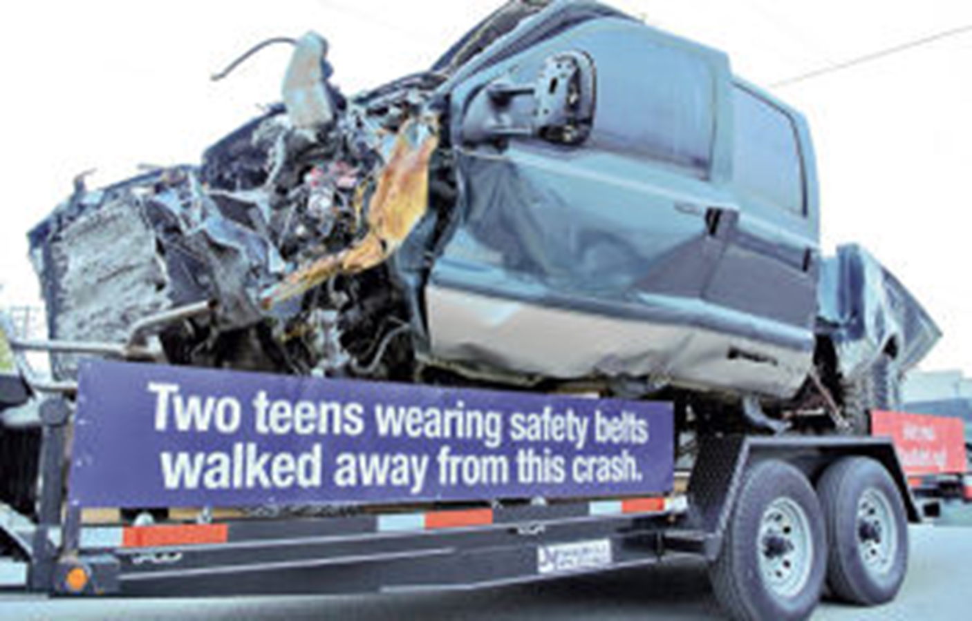
Crashes happen
What happened to the
driver and passenger?
Photo: Texas Dept. of Transportation
13
Notes:
Allow me to share a real-life story with you. Early one morning in February 2009, Ethan Mitchell, was driving the truck pictured here with a friend, Trey Mohler, as the passenger. Suddenly a tire blew out and the truck hit a cement culvert. The truck flipped before crashing with the ground. Take a good look at this mangled vehicle. Anyone care to guess how the driver and passenger fared?

Slide 14
Seat belts save lives!
Photo: Texas Dept. of Transportation
14
Notes:
It’s hard to believe, but not only did they survive the crash….they walked away. Both the driver and passenger were suspended upside down, held in place by their seat belts and airbags. Paramedics rushed them both to the hospital to be treated for minor injuries. Mitchell had a sprained ankle, and Trey needed stitches in his head. The next day, both walked out of the hospital—barely scratched– and showed hogs at a livestock festival where they won an award.
This is a scary scenario with a happy ending. Imagine how different this story would have been had the driver and passenger not been wearing their seat belts!
*Photo and story from the Texas Department of Transportation as part of its Click it or Ticket Campaign.

Slide 15
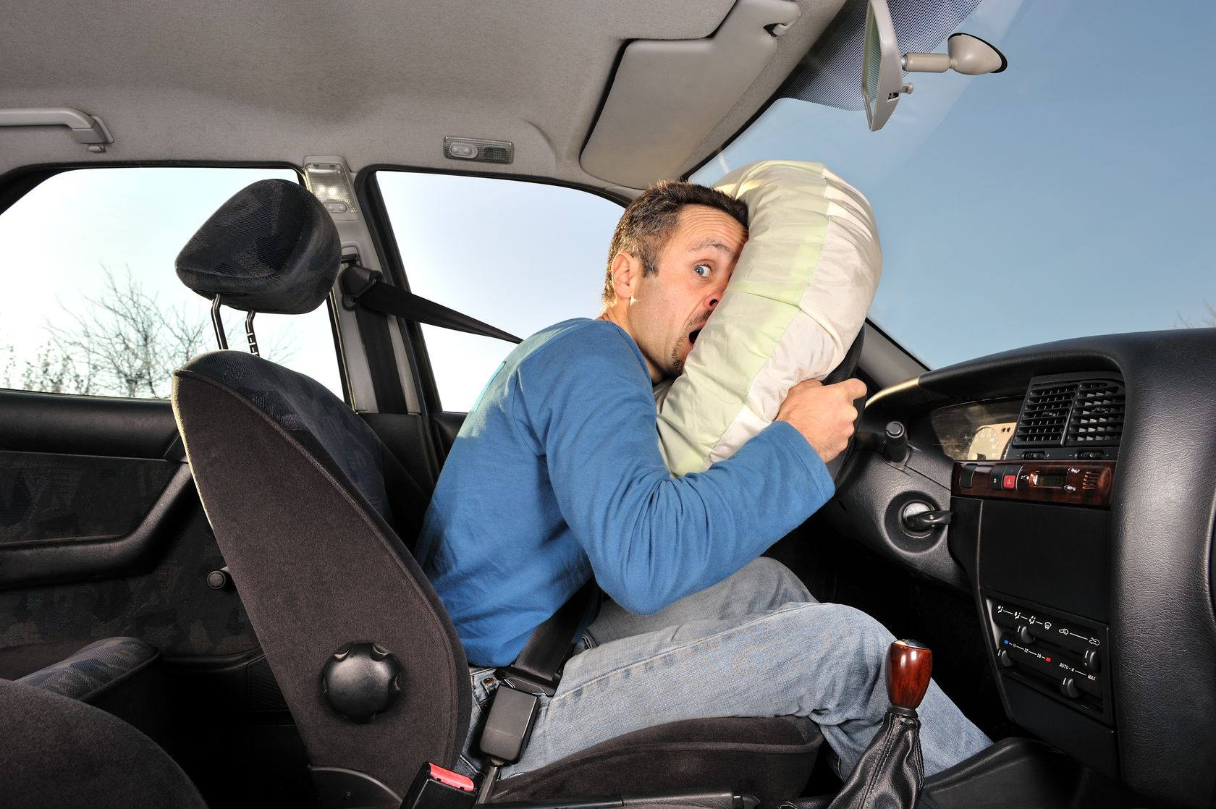
Personal testimonials
15
Notes:
I’ve made my case for buckling up on every trip, every time. Now I’d like to invite anyone in the audience to share a personal story of his or her own or of someone they know where they were either saved by the belt, or maybe could have been.
Speaker’s Note: Be sure to have someone “primed” to break the ice in case you’re not getting volunteers and have a story or two of your own as a back up.

Slide 16
Call to action
Current belt rate based on observation is X
We would like to see __% of employees buckling up
Seat belt campaign directed to all employees (not just company drivers)
Share info with family and friends and encourage them to buckle up on every trip
16
Notes:
In preparation for Drive Safely Work Week, we observed employees coming into work to determine the rate at which we’re buckling up here at_______. That rate was XX %. Because we care about your safety and well-being and we’re all one big family here at ______ , we would like to see this rate improve to ____. Today we embark on a campaign to not just get all of our employees buckling up on every trip, but to also provide you with information to share with your family members and friends to get them buckled up as well.
Note: The Seat Belt Myths and Facts sheet may be used as a handout.

Slide 17
Additional information
Transporting kids or know someone who is?
Guidelines have changed in the past couple of years
Handout available with new guidelines
Please share with family, care-givers and friends
17
Notes:
Presenter’s Note: You might do an online search for a list of child passenger safety seat checks in your community to send home with anyone who has the responsibility of transporting small children or who knows someone who does.
You can print a hand out to send home with employees from the National Highway Traffic Safety Administration’s Traffic Safety Marketing, found in the Additional Resources tab.

Slide 18
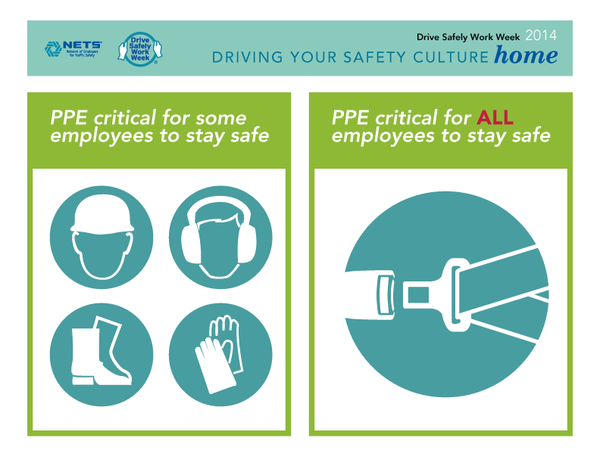
Thoughts or Questions?
18

