Slide 1
Making safe driving for all
Part of the corporate safety culture
www.trafficsafety.org
Notes:
If your organization is not already addressing road safety for all employees (not just company drivers) as a part of its safety culture, it’s missing a significant safety issue. This presentation is intended for Executive Leadership to review. Ideally, the information will then cascade down to all levels of management in an effort to implement education and awareness activities– accompanied by policies and guidelines if appropriate– on the issues of seat belts and mobile device use while driving. Addressing these two issues is a good place to start with including elements related to road safety as part of the organization’s core safety culture.

Slide 2
Nearly All Employees Drive Daily
Whether employees drive as a part of their work, commuting to and from work, or around town after they've left work, DRIVING is likely the riskiest thing they do on a daily basis.
2

Slide 3
Characteristics of a Serious SAFETY CULTURE
Safety initiatives:
Are proactive not reactive;
Extend beyond the manufacturing sites and labs;
Are viewed as an investment, not a cost;
Are resourced with safety professionals;
Reflect values vs. priorities (values don’t change– priorities can);
Don’t exist in “silos” (each dept. only concerned with its own team)
The bottom line:
The SAFETY CULTURE of the organization extends beyond its doors; and
People are doing the right thing even when no one is watching.
3

Slide 4
What Contributes Significantly to Employee Losses?
Motor vehicle crashes (MVCs) are the leading cause of on-the-job deaths and the second leading cause of off-the-job deaths.¹
On-the-job MVCs result in highest cost per workers’ comp claim.²
In 2012, nearly 60,000 U.S. workers lost their lives as a result of unintentional injury either at work or away from work.¹
1 in 3 of these deaths were from motor vehicle crashes.¹
4
Notes:
The loss or injury of an employee whether it occurs on or off the job is still the loss of a valuable resource, whether it be temporary or permanent. It’s safe to assume a significant portion of employees are driving at some point during the day. In 2012, more than 33,000 people lost their lives in traffic crashes in the U.S. alone. That means with 20,000 deaths as a result of traffic crashes both on and off the job, nearly 2/3 of people killed in the U.S. were members of the workforce.
¹ National Safety Council Injury Facts®2014 Edition
² National Council on Compensation Insurance (NCCI) 2010-2011 data

Slide 5
Where Are You on the ROAD SAFETY Staircase?
Corporate
Social
Responsibility
It’s not uncommon for efforts to stop here
Community
Outreach
Employee
Families
Entire
Workforce
Company Drivers
Minimal
Attention
5
Notes:
If you have no road safety program of any kind, the first step of starting a program can feel like a big one. But there are resources available to help. Start by taking a look at the NETS Comprehensive Guide to Road Safety™ (available at no cost via the NETS website at www.trafficsafety.org or via the link in the Additional Resources tab of the DSWW campaign website.)
If you already have a road safety program in place for your business drivers, extending elements of the program to all employees is the next step. Look at your fleet safety program and determine which components can be expanded to all employees. This does not have to be a high-cost step. The 2014 DSWW tool kit will also give you ideas on where to start.
Traffic crashes that affect employee family members affect your employees. Extending programs and resources to family members (i.e., child passenger safety information, teen driving programs, tire maintenance) helps emphasize that the safety culture at work should extend beyond the doors of the facility.

Slide 6
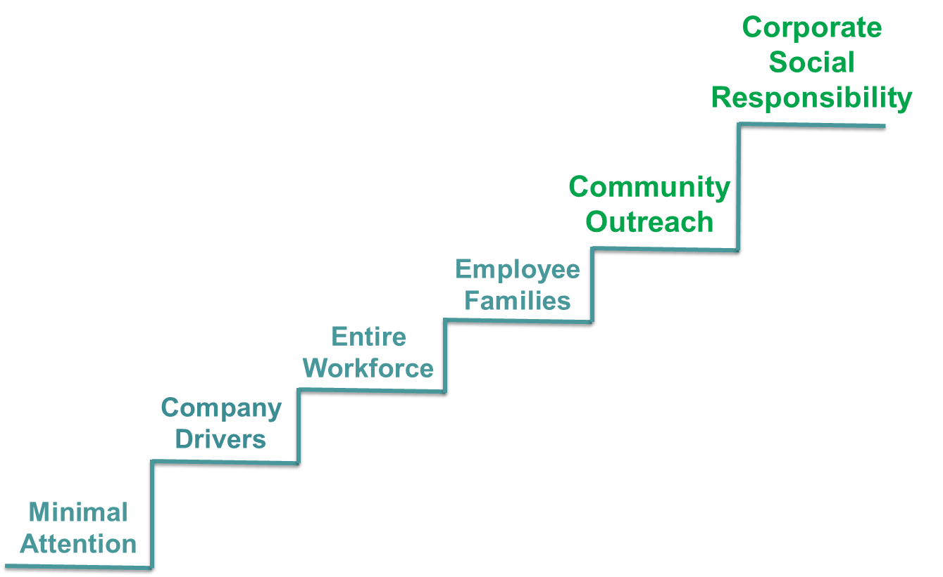
Where Are You on the ROAD SAFETY Staircase?
6
Notes:
Employers can be very influential members of the community. Extending road safety programs that focus on seat belts, child passenger safety and teen driving, for example, is a great way to demonstrate good corporate citizenship, affect the safety of those sharing the roads with your employees and give back to the community.
Elevating road safety to the level of Corporate Social Responsibility means road safety has been elevated to the status of other CSR/sustainability initiatives such as water use and conservation, land use and conservation and air quality, to name a few. At this step, resourcing and funding is made available to international NGO’s for road safety programs. Examples of programs funded by NETS member companies include free helmet distribution to children in Vietnam and resources provided in Africa for the establishment of highway patrol. The first step in the Road Safety Staircase is a big one, but not at big as the last.

Slide 7
Evolution of a ROAD SAFETY Program
Building a ROAD SAFETY Culture
Fleet Drivers
All Employees & Contractors
Family & Community Members
Executive leadership has acknowledged driving is likely the riskiest thing any employee does daily.
Identify and prioritize threats and defenses.
- Be sure to include contractors as well
Leverage existing infrastructure
- Use NETS Comprehensive Guide to Road Safety™ (free-of-charge download)
Work toward program extension and sustainability.
7
Notes:
Executive leadership has acknowledged that driving a vehicle is very likely the riskiest thing any employee does on a daily basis– whether they drive for work, to and from work and/or outside of work– and is therefore committed to road safety as an integral part of a company’s safety program. This realization oftentimes follows a tragic event, but if one looks at what other companies are doing (as a result of a tragedy) much can be learned and implemented, ideally before tragedy strikes.
Identify and prioritize threats and defenses (i.e., for all employees: non-use of seat belts, using drive time to conduct business by phone) and be sure to include contractors when designing policies, guidelines, countermeasures, etc.
Use existing infrastructure. If your organization has a fleet, components of the fleet safety program can and should be leveraged to design a road safety program to reach all employees. Review NETS’ Comprehensive Guide to Road Safety™ and work toward program sustainability. How can you keep road safety top of mind throughout the year and create opportunities to extend your program to family members and the community? The DSWW tool kit has ideas and activities to assist with this.

Slide 8
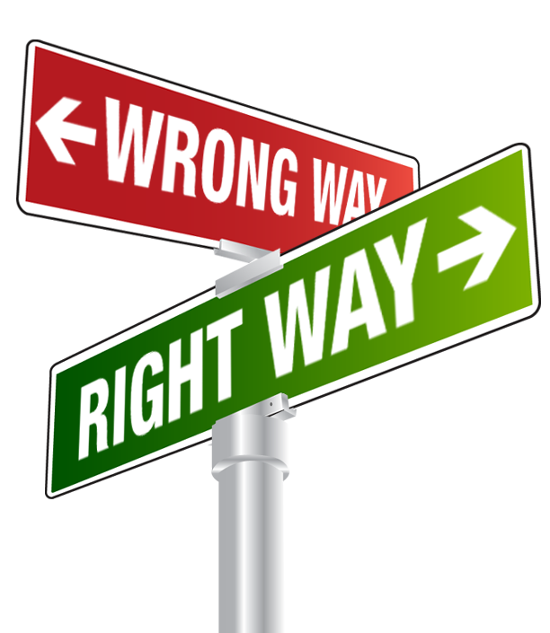
Building a ROAD SAFETY Culture
The WRONG Way - Rushed, following a galvanizing, high cost event.
The RIGHT Way - Planned, researched, resourced and focused.
Build as you go.
Apply change management principles.
8

Slide 9


Learn from Others– Don’t Wait for a Tragic Event
“We had a comprehensive vehicle
safety program in place for our
business drivers but realized we
were losing PhD scientists and
executives – among other valuable
employees – to traffic crashes. We
knew we needed to put a road safety program in place to reach all of our
people.”
“We looked at our employee losses
over a 12-month period and
discovered that worldwide, more
than 75% were killed in crashes
commuting to and from work.”
These are real scenarios from NETS member
companies. Names and company names have
been redacted.
9

Slide 10
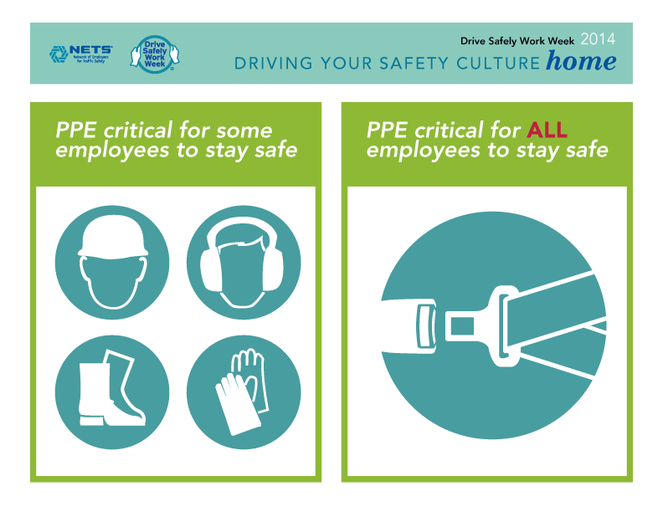
Start With Seat Belt Use
Seat belts save an estimated 12,000 lives and prevent 325,000 serious injuries each year in the U.S. alone.³
Personal Protection Equipment (PPE) isn’t just for the plant floors. Think of seat belts as critical PPE for every employee.
10
Notes:
The DSWW tool kit provides ideas and resources to communicate the importance of buckling up on every trip and shows that seat belts are an important piece of PPE that all employees should be using regardless of the job they do.
³ OSHA, NHTSA and NETS, https://www.osha.gov/Publications/motor_vehicle_guide.html

Slide 11
Seat Belts Save Lives and Reduce Serious Injury
Survivors of motor vehicle crashes who
wore their seat belts had:
Fewer head injuries (30% vs. 50% unbelted).⁴
Medical bills that were half of those who were unbelted.⁴
Fewer lost work days compared to those who were unbelted– An estimated 7.3 million additional work days were lost over a 5-year period due to lack of seat belt use.⁵
11
Notes:
Seat belts are an excellent place to start with integrating elements of road safety in the core safety culture of the organization. Policies that require the use of seat belts and prohibit the use of mobile devices while driving are key elements of the safest fleets*– both issues are most likely ingrained into the safety culture of the fleet department. We’ve seen examples of organizations that do use policies and guidelines on seat belt use for all employees while driving on company property. If employees must wear their seat belts as they leave the organization’s parking lot or garage, chances are they won’t unclick them as they exit the property and the habit will take root. A sample policy/guideline is included in the DSWW tool kit.
⁴ Survivors of motor vehicle trauma: an analysis of seat belt use and health care utilization , D A Redelmeier, P J Blair, Journal of General Internal Medicine (1993) Volume: 8, Issue: 4,
⁵ Is seat belt use associated with fewer days of lost work after motor vehicle collisions?, Metzger, McGwin, MacLennan, and Rue, The Journal of Trauma (2004) Volume: 56, Issue: 5, Pages: 1009-1014
*NETS STRENGTH IN NUMBERS™ Road Safety Benchmark Report, 2013 (members-only publication.)

Slide 12
Mobile Device Use While Driving
26% of crashes in the U.S. (nearly 1.5 million) involve talking and texting on cell phones.⁶
21% involved talking on a handheld or hands-free cell phone, and 5% involved text messaging.⁶
More than 30 studies have shown that hand held and hands-free devices pose similar risk due to the cognitive distraction of both.
12
Notes:
⁶ National Safety Council Injury Facts®2014 Edition

Slide 13
Concerns for Employers
Employees who are…
Participating in conference calls…
Talking with managers or co-workers…
Reading or responding to e-mail…
Conducting any type of business while driving…
…put their safety, the safety of other road users
and the employer’s bottom line at risk–
even if on a personal device
and driving a personal vehicle.
13

Slide 14
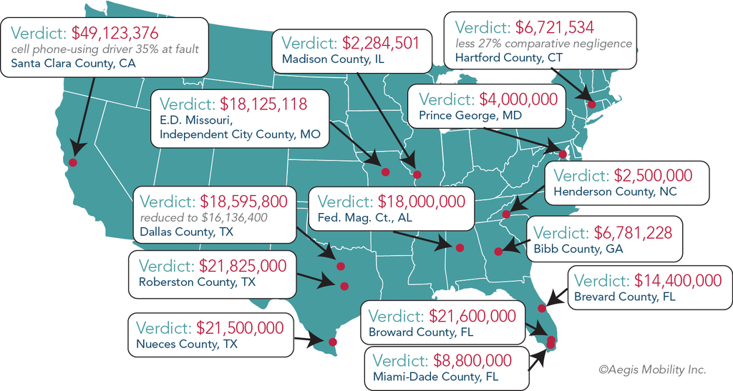
Mobile Device Use Behind the Wheel: Issue of Safety & Liability
“With more and more employees using their personal devices for work-related issues, employers must be cognizant that such use inextricably tethers the employee’s device to an employer’s liability.”
Brian L. Champion, partner at Libby O’Brien Kingsley & Champion, LLC
Graphic used with permission from Aegis Mobility, Inc.
14
Notes:
Nearly all U.S. states now have laws against texting and driving and most also have “distracted driving” statutes which may impose liability on an employer who has knowledge of or is permitting the use of mobile devices by employees to conduct business while driving.
When evaluating direct-negligent distracted driving claims, courts look at whether the employer:
organized work such that the employee was expected to use his or her mobile device while driving;
implemented adequate policies to prohibit or discourage mobile device use while driving;
had actual or constructive knowledge that the employee was engaging in risky behavior;
warned about the hazards and risks associated with distracted driving; and/or
(5) hired an employee with a poor driving record.⁷
⁷Aegis Mobility white paper: Employee Distracted Driving– Understanding Your Business Risk and Liability, 2013

Slide 15
Why all Employees Should be Included in a Mobile Device Policy
Scenarios of distracted driving verdicts against
employers have involved employees who were:
Driving after normal business hours;
En route to a personal event;
Sightseeing on a business trip;
Operating a personal vehicle; and/or
Utilizing a personal mobile device.⁸
15
Notes:
Generally speaking, an employee is acting within the scope of employment if his or her conduct benefits the employer – in any way. Using this standard, courts have routinely allowed claims against employers to proceed in court even when the crash occurred under the above scenarios.⁸
⁸ Aegis Mobility white paper: Employee Distracted Driving– Understanding Your Business Risk and Liability, 2013
See document for specific case citations- http://www.aegismobility.com/distracted-driving/images/research/whitepapers/Distracted-Driving-Business-Risk-White-Paper-Aegis-Mobility.pdf

Slide 16
Mobile Device Responsibility as Part of Corporate Safety Culture
Employers should:
Not create or imply a culture where employees feel that they need to make or take calls or read or reply to emails while driving.
Get buy-in and commitment from management at all levels that they will not contact employees’ cell phones during times they know to be their drive times.
Prohibit by policy any employees from participating on conference calls while driving.
Provide on-going education and awareness messaging about the dangers of using a mobile device while driving.
16

Slide 17

Driving Your Safety Culture Home
It takes courage to adopt a safe-driving culture.
The effort must be championed by leadership.
Keep in mind first-line supervisors are leaders, too.
This year’s Drive Safely Work Week tool kit has materials and ideas to assist your efforts.
17

